Slide 1
HEART RATE AND BREATHING MONITOR
Group 5

Slide 2
Introduction
Heart rate monitor
This is a chest strap device which has embedded electronics to collect Electrocardiograph (ECG) signal.
This could be fairly useful for everydays peoples life, having their own device at home and being able to monitor their health.
It has 3 different modes: Fitness, Stress monitoring, and meditation mode

Slide 3
Purpose
Heart Rate and respiratory-rate monitoring wearables could be used in the areas of mediation and fitness for both children and adults
Help people monitor their heart rate and check their health regularly
3 different modes, Stress mode, fitness mode, and meditation mode

Slide 4
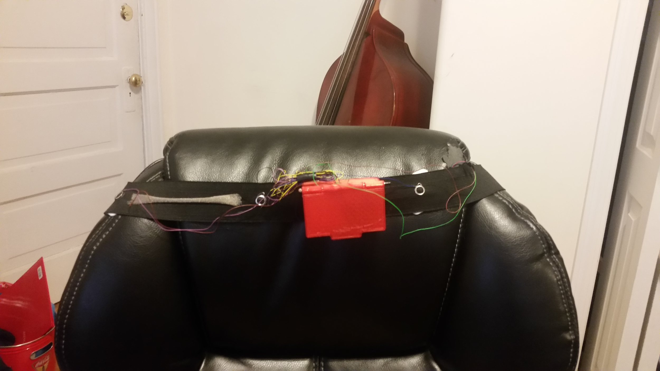
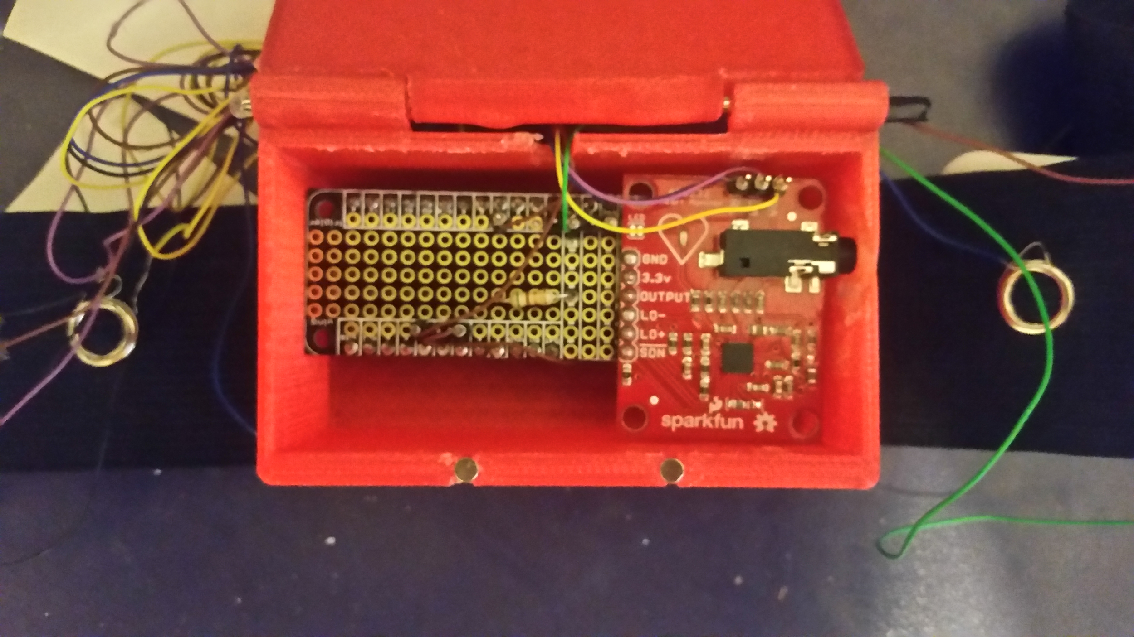
Device

Slide 5
How to know which mode?
The mode’s are mainly distinguished by breathing rate.
Fitness mode: Determined by heart rate increasingly fast
Stress Mode: Determined if you usually by held breathing
Meditation Mode: heart beat is steady and slow

Slide 6
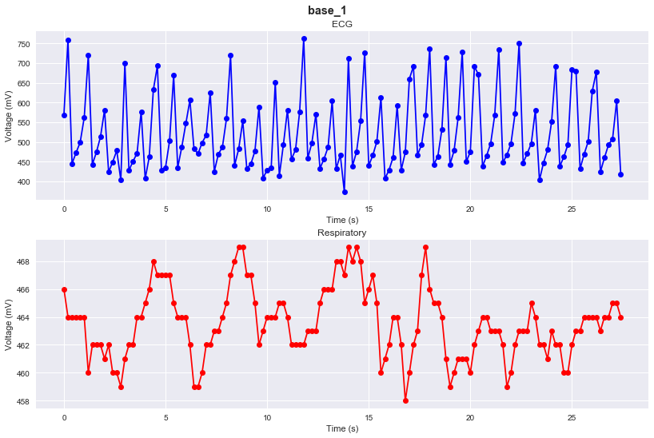
Baseline data
Heart Beat Count: 34 Heart Rate: 74.45 beats/min Cardio Zone: Very Light breath count: 11 Respiratory Rate: 24.09breaths/min Average Inhalation Duration: 1.07 sec Average Exhalation Duration: 1.14 sec

Slide 7
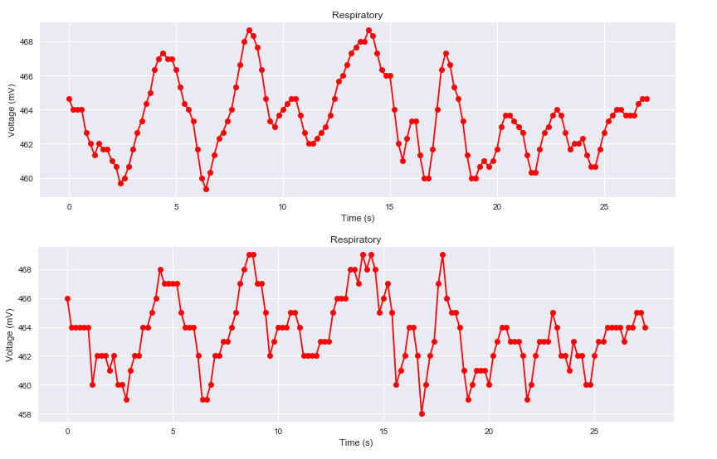
Noise reduction Moving Average Filter
Using base_1 respiratory
N = 3 cumsum, moving_aves = [0], [] time2 =[] for i, x in enumerate(resp, 1): cumsum.append(cumsum[i-1] + x) if i>=N: moving_ave = (cumsum[i] - cumsum[i-N])/N #can do stuff with moving_ave here moving_avesresp.append(moving_ave)

Slide 8
Calculations
Heart Breathing
heartcount=0 truecounter='false' for x in range(2,len(data.index)): if ECG[x] > ECG[x-1] and truecounter == 'false': heartcount=heartcount+1 truecounter = 'true' if ECG[x] < ECG[x-1]: truecounter = 'false'
heartrate=heartcount/((time[len(time)-1]/60))
if heartrate>.9*maxheartrate: print('Cardio Zone: Maximum') elif heartrate>.8*maxheartrate and heartrate<.9*maxheartrate: print('Cardio Zone: Hard') elif heartrate>.7*maxheartrate and heartrate<.8*maxheartrate: print('Cardio Zone: Moderate') elif heartrate>.6*maxheartrate and heartrate<.5*maxheartrate: print('Cardio Zone: Light') elif heartrate<.6*maxheartrate: print('Cardio Zone: Very Light')
breathingcount=0 truecounter='false' inhalation = [] exhalation = [] for x in range(2,len(data.index)): if resp[x] > resp[x-1] and resp[x-1] > resp[x-2] and truecounter == 'false': breathingcount=breathingcount+1 truecounter = 'true' inhalation.append(time[x]) if resp[x] < resp[x-1] and resp[x-1] <= resp[x-2] and truecounter == 'true': truecounter = 'false' exhalation.append(time[x]) print('breath count: {0}'.format(breathingcount)) respiratoryrate=breathingcount/((time[len(time)-1]/60)) print('Respiratory Rate: {0} breaths/min'.format(respiratoryrate)) if not len(inhalation) == len (exhalation): del inhalation[-1] inhalationdurlation=np.subtract(exhalation, inhalation) delinhalation=inhalation[:] delexhalation=exhalation[:] delinhalation.pop(0) delexhalation.pop(-1) exhalationdurlation = np.subtract(delinhalation, delexhalation)

Slide 9
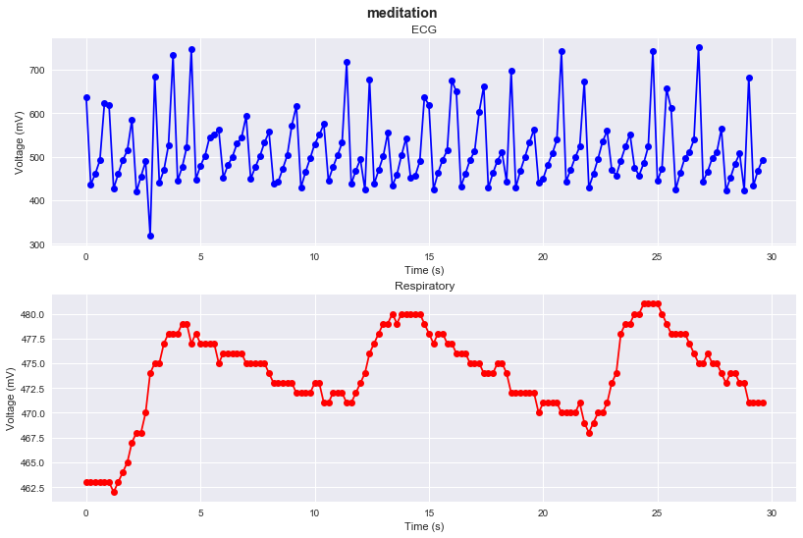
Meditation
Heart Beat Count: 33 Heart Rate: 66.89 beats/min Cardio Zone: Very Light breath count: 3 Respiratory Rate: 6.08 breaths/min Average Inhalation Duration: 2.87 sec Average Exhalation Duration: 7.5 sec Ratio = 2.61
The ratio is to be used to a cut off for the buzzer

Slide 10
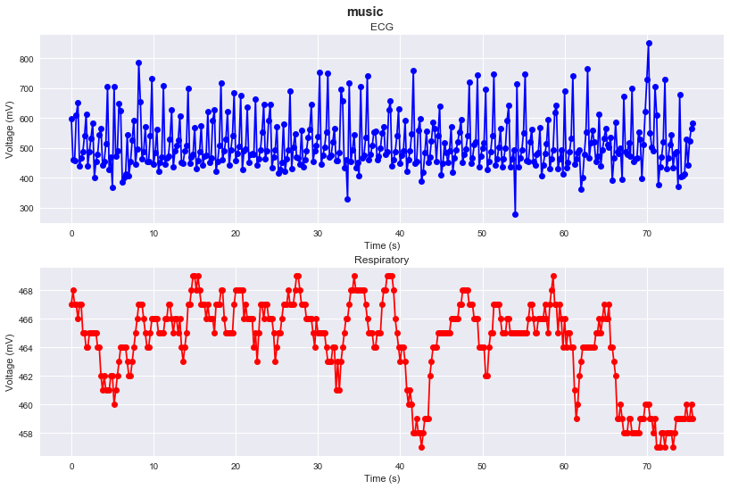
Music
Heart Beat Count: 96 Heart Rate: 76.190 beats/min Cardio Zone: Very Light breath count: 15 Respiratory Rate: 11.90 breaths/min Average Inhalation Duration: 1.74 sec Average Exhalation Duration: 2.77 sec

Slide 11
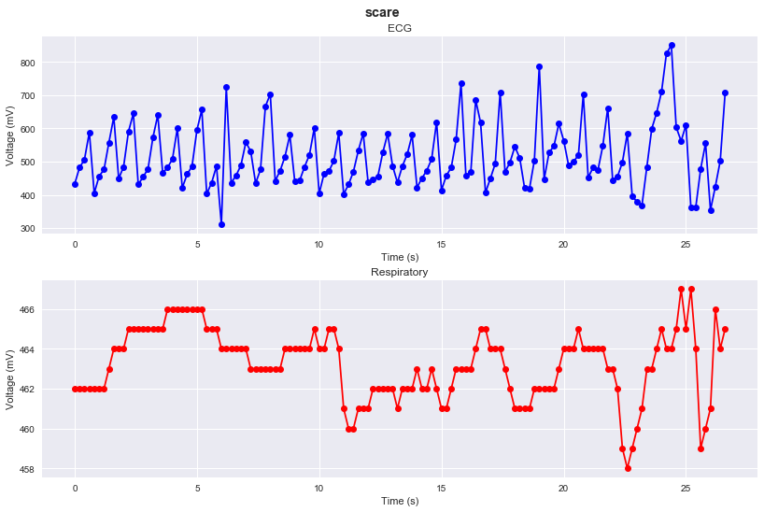
Stress
Heart Beat Count: 31 Heart Rate: 69.92 beats/min Cardio Zone: Very Light breath count: 5 Respiratory Rate: 11.28 breaths/min Average Inhalation Duration: 2.4 sec Average Exhalation Duration: 4.8 sec

Slide 12
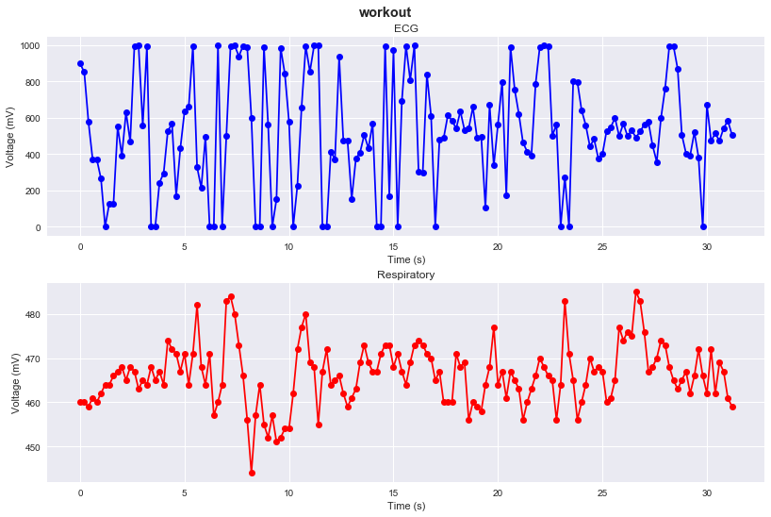
Workout
Heart Beat Count: 46 Heart Rate: 88.46 beats/min Cardio Zone: Very Light breath count: 16 Respiratory Rate: 30.77 breaths/min Average Inhalation Duration: 0.87 sec| Average Exhalation Duration: 0.99 sec
The long delay of 200ms contributed to the inability to get a reasonable heart rate value

Slide 13
Problems
Limited data gallery
Delay signal affected the data, it was difficult to find a good midpoint to retract good data.

Slide 14
Conclusion
In conclusion this could be a device that could be worn by many people at home and outside
Saves trips going to the doctor to monitor your health by ECG signal
More likely for people
It has three different modes which the use can switch between via bluetooth
Would be made affordable for people

Slide 15
Thank You

